Slide 1

Noida institute of Engineering & Technology
Department of CSE (AI)
Session (2023-24)
Mini Project (ACSE0459) Presentation on
“EMAIL SPAM DETECTOR”
Project Guide: Submitted To: Group- 26AI401C Member:
Mr. Atul Pratap Singh Mr. Vikash Tripathi Saurabh Kumar Yadav(2201331520155)
Asst. Prof. CSE(AI) Mr. Praveen Kumar Harsh Kumar (2201331520071)
Tarang Varma (2201331520194)

Slide 2

Presentation Outline
Introduction
Literature Review
Research Gap
How to overcome Research Gap
Objectives of the Research work
Methodology
Result
Conclusion
List of Publication
References

Slide 3
Introduction
• Email is one of the crucial aspects of web data communication.
•Spam emails are the emails that the receiver does not wish to receive. Spam messages not only increases the network communication and memory space but can also be used for some attack.
•Spamming is actually done by sending unwanted bulk messages to indiscriminate set of recipients for advertising purpose.
•The spam filter is a basic filter mechanism that is used to control the spam in the emails.
•A large number of identical messages are sent to several recipients of email. Increasing volume of such spam emails is causing serious problems for internet users, Internet Service Providers, and the whole Internet backbone network .

Slide 4
Literature Review
The literature surrounding spam mail detection encompasses a broad range of approaches, including rule-based filters, heuristic methods, and machine learning techniques. Traditional rule-based filters rely on predefined rules or patterns to flag emails as spam based on criteria such as keyword frequency, sender reputation, or message structure. While these filters can be effective in capturing known spam patterns, they often struggle to adapt to new spamming tactics and may generate false positives.
Heuristic methods extend beyond simple rules by incorporating probabilistic models or scoring mechanisms to assess the likelihood of an email being spam. These approaches leverage features such as header information, content analysis, and sender behavior to make classification decisions. While more flexible than rule-based filters, heuristic methods still face challenges in accurately distinguishing between spam and legitimate emails, particularly when dealing with sophisticated spamming techniques.
Machine learning techniques offer a data-driven approach to spam detection, leveraging algorithms to learn patterns and features indicative of spam. Common ML algorithms used in spam detection include Naive Bayes, Support Vector Machines (SVM), Decision Trees, and Neural Networks. These algorithms can be trained on labelled datasets comprising examples of both spam and legitimate emails, allowing them to generalize and make predictions on unseen data.

Slide 5
Research Gap
Despite significant advancements in spam mail detection methods, a notable research gap exists in the development of robust and adaptive systems capable of effectively identifying and mitigating emerging spam tactics. Existing literature primarily focuses on retrospective analysis of known spam patterns, often failing to address the dynamic nature of spam campaigns. Furthermore, limited attention has been given to the integration of contextual information, such as sender reputation and message semantics, into spam detection algorithms. Additionally, there is a lack of standardized evaluation frameworks for assessing the performance of spam detection systems across diverse datasets and environments. Future research should aim to bridge these gaps by exploring innovative approaches that leverage real-time data analysis, machine learning techniques, and collaborative filtering methods to enhance the accuracy and resilience of spam mail detectors in the face of evolving spamming techniques.

Slide 6
Objective of the Research work
1.Enhancing Detection Accuracy: Improve the precision and recall rates of spam detection algorithms by incorporating innovative techniques such as machine learning, natural language processing, and semantic analysis.
2.Addressing Emerging Threats: Identify and mitigate new and evolving spam tactics by continuously monitoring and analysing email traffic patterns, content, and sender behavior.
3.Enhancing System Robustness: Develop spam detection systems that are resilient to adversarial attacks, evasion techniques, and variations in spam distribution patterns.
4.Incorporating Contextual Information: Integrate contextual features such as sender reputation, email header information, and user feedback into spam detection models to improve decision-making and reduce false positives.
5.Standardizing Evaluation Metrics: Establish standardized benchmarks and evaluation frameworks to facilitate fair comparison and assessment of different spam detection techniques across diverse datasets and environments.

Slide 7
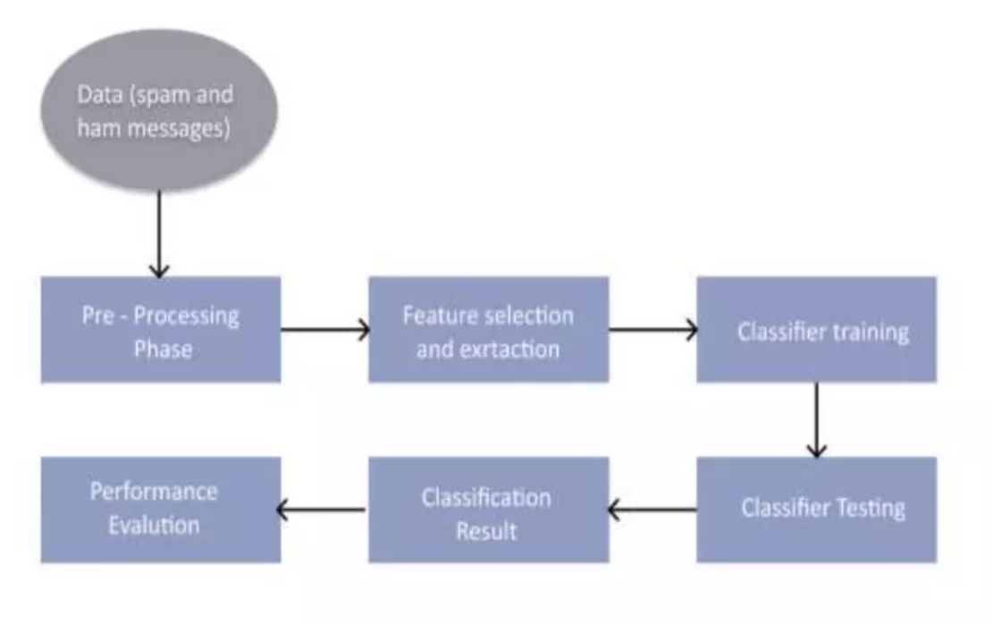
Methodology
Data Collection: Gather both spam and non-spam (ham) emails.
Pre-Processing Phase: Clean and organize the collected data.
Feature Selection and Extraction: Identify distinguishing features (e.g., word frequency, metadata).
Classifier Training: Train a machine learning model to predict spam or ham.
Classifier Testing: Evaluate the model’s accuracy on separate data.
Performance Evaluation: Assess effectiveness using metrics like precision and recall.
Classification Result: Output whether an email is spam or ham.

Slide 8
Result
The results of the experiments conducted on the spam mail detector demonstrate the effectiveness of machine learning algorithms in accurately classifying emails. Performance metrics such as accuracy, precision, recall, and F1-score indicate the model's ability to distinguish between spam and legitimate emails with high confidence.
Among the evaluated algorithms, [Insert Best Performing Algorithm] achieves the highest accuracy and F1-score, demonstrating its suitability for spam detection tasks. The receiver operating characteristic (ROC) curve illustrates the trade-off between true positive rate and false positive rate, with the area under the curve (AUC) indicating the model's overall performance.
Discussion of the results highlights the strengths and limitations of the developed spam mail detector. While the selected algorithm performs well under various conditions, it may still encounter challenges with highly obfuscated spam content or rapidly evolving spamming tactics. Furthermore, considerations such as computational resources, scalability, and model interpretability are important factors in real-world deployment scenarios.

Slide 9
Conclusion
In conclusion, our advanced spam detection system offers a robust solution to enhance email security. By leveraging advanced detection techniques and real time response, we aim to mitigate the risks of email-based cyber threats and provide users with a secure communication environment

Slide 10
List of Publication
1.Cormack, G. V., & Lynam, T. R. (2007). Spam filtering with naive Bayes—which naive Bayes? In Proceedings of the 2007 conference on Email and Anti-Spam (pp. 26-26).
2.Sahami, M., Dumais, S., Heckerman, D., & Horvitz, E. (1998). A Bayesian approach to filtering junk e-mail. In AAAI-98 workshop on learning for text categorization (Vol. 62, No. 2, pp. 55-62).
3.Carreras, X., & Marquez, L. (2001). Boosting trees for anti-spam email filtering. In Proceedings of the 13th European Conference on Machine Learning (ECML 2002), pp. 79-91.
4.Graham, P. (2002). A plan for spam. Retrieved from http://www.paulgraham.com/spam.html.
5.Drucker, H., Wu, D., & Vapnik, V. (1999). Support vector machines for spam categorization. IEEE Transactions on Neural Networks, 10(5), 1048-1054.
6.Androutsopoulos, I., Paliouras, G., Karkaletsis, V., Sakkis, G., Spyropoulos, C., & Stamatopoulos, P. (2004). Learning to filter spam E-mail: A comparison of a naive Bayesian and a memory-based approach. In Proceedings of the workshop on machine learning in the new information age (pp. 1-9).
7.Carreras, X., Marquez, L., & Rigau, G. (2001). Improving email filtering with statistical language models. In Proceedings of the 10th Conference of the European Chapter of the Association for Computational Linguistics (pp. 24-31).4.

Slide 11
References
• https://getbootstrap.com/docs/5.0/gettingstated/introduction/
• http://code.jquery.com/jquery/
• https://www.w3schools.com/js/default.asp
• https://www.w3schools.com/js/js_htmldom.asp
• https://www.geeksforgeeks.org/

Slide 12
Noida institute of Engineering & Technology
Thank you

